Slide 1
Class 07

Slide 2
LED

Slide 3
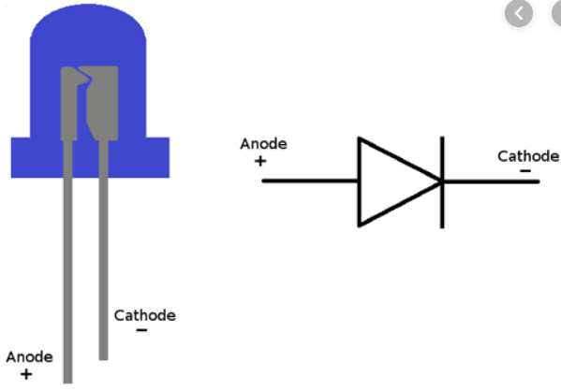

Slide 4
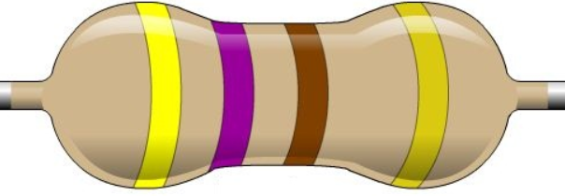

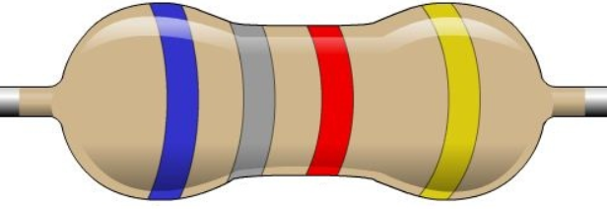

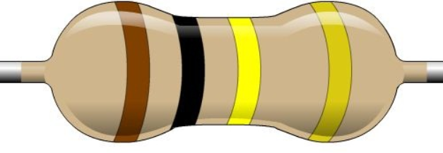
470 Ohm
1K Ohm
6.8K Ohm
10K Ohm
100K Ohm

Slide 5
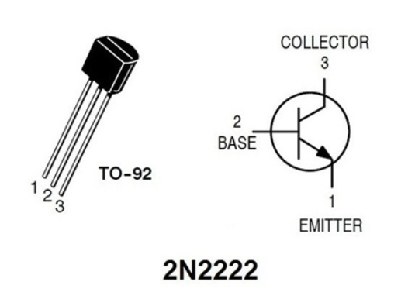

Slide 6
LRD Circuit Diagram

Slide 7
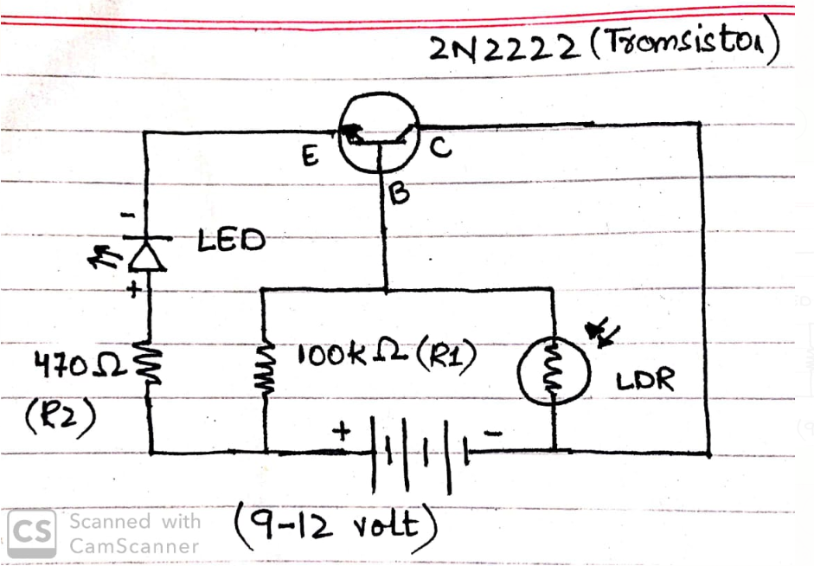

Slide 8
Flip Flop Circuit Diagram

Slide 9
